Slide 1
Productivity & Technology Management
Presentation By: Chetan Raikwar
Faculty IIPS-DAVV, Indore

Slide 2
Factor
Affecting
Productivity

Slide 3
Technical
Personnel
Finance
M
A
N
A
G
E
M
E
N
T
G
O
V
E
R
N
M
E
N
T
Factor
Affecting
Productivity
Production
Market
Organization

Slide 4
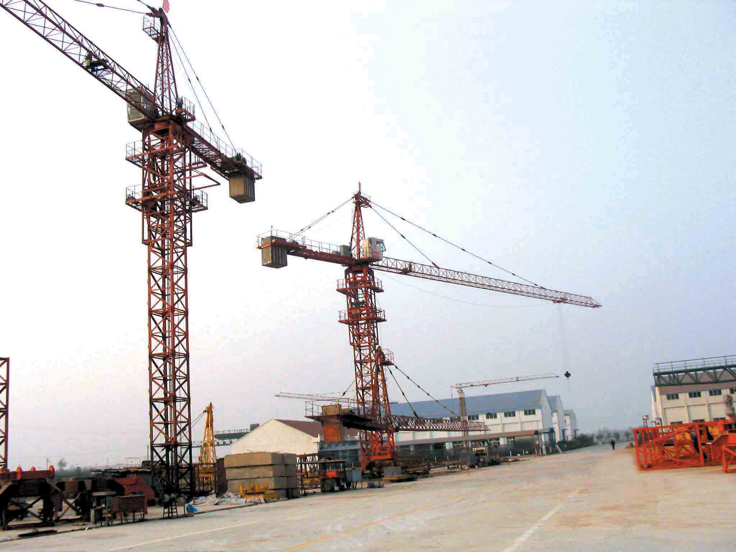
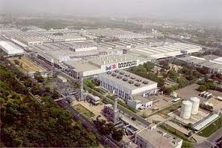

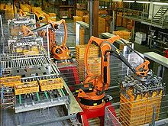

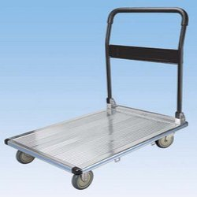
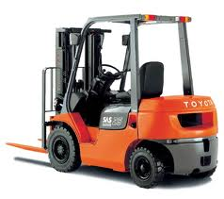


Technical
Factor
Technology
Innovations
Modern Equipment
Plant & Machinery
Good Maintenance
Operational Cost

Slide 5
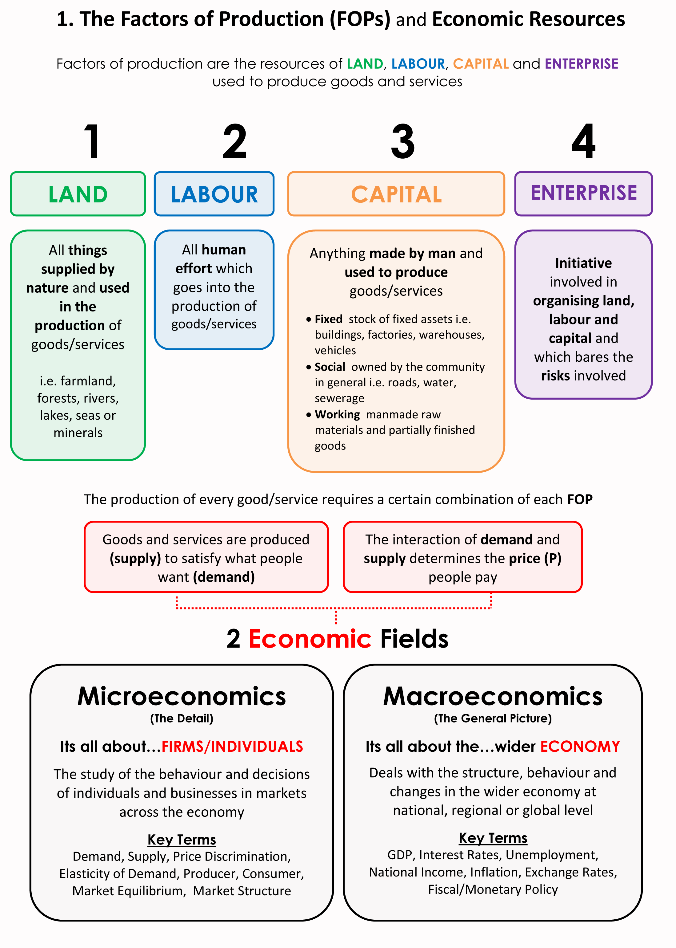
Production Factor

Slide 6
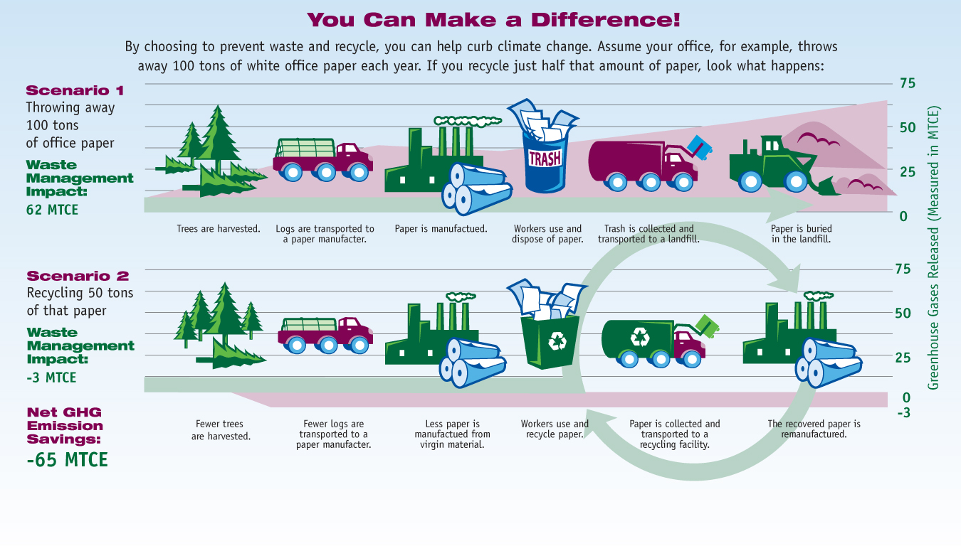
Production Factor
Material Yield
Use of Wastage
Material
Import Substitute
Inventory Cost
Additional Supplier
Purchasing

Slide 7



Simplification is the process of reducing the variety of products manufactured.
Simplification is concerned with the reduction of product range, assemblies, parts, materials and design.
Simplification involves fewer, parts, varieties and changes in products; this reduces manufacturing operations and risk of obsolescence.
Simplification reduces variety, volume of remaining products may be increased.
Simplification provides quick delivery and better after-sales services.
Simplification reduces inventory and thus results in better inventory control.
Simplification lowers the production costs.
Simplification reduces price of a product.
Simplification improves product quality.
Production Factor
Checking the work overload.
Checking upon the work under load.
Ensuring tasks are not repetitive in nature.
Ensuring that employees don not remain isolated.
Defining working hours clearly.
Defining the work processes clearly.
Standardization
Volume v/s Variety
Method
Simplification
Job Design
Capacity Utilization
Higher fixed costs per unit mean reduced profitability
Spare capacity can portray a negative image
Staff can become bored and demoralised

Slide 8

Financial Dynamics
Investment
Capital-Labour Ratio
Finance
Capital Structure
Return on Investment
Research & Development

Slide 9
Management Factor
M
A
N
A
G
E
M
E
N
T
Poor Planning & Scheduling
Unclear and untimely Instruction
Inability to adjust staff size
Material Flow
Layout
Unavailability of needed tools
Excess Travel Time
Supervision Problem

Slide 10
Management Factor
M
A
N
A
G
E
M
E
N
T
Physical Working Conditions
Motivation
Leadership
Communication skills
Teamwork
Coordination & Cooperation
Job Satisfaction
Conflict
Change

Slide 11


Personnel Factor
Reduced Productivity
Inflexible working Rules
Unions’ Influence
Excessive Benefits
Reduced Company Loyalty

Slide 12



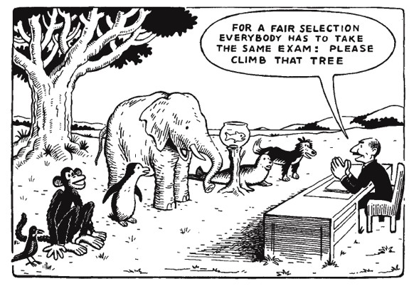







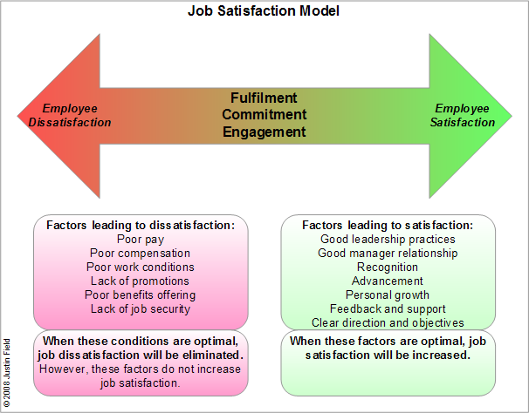



Personnel Factor
Worker fear about loss of job
Work Ethics
Personnel
Worker Force Mix
HR Policies
Motivation
Absenteeism & late coming
Standard of Performance
Job Satisfaction

Slide 13

Organization Factor
As a System
Management Style
Organization
Organisation Intent
Culture
Structure
Technology Infrastructure

Slide 14

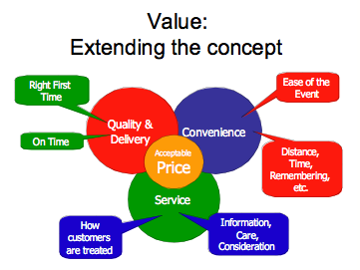
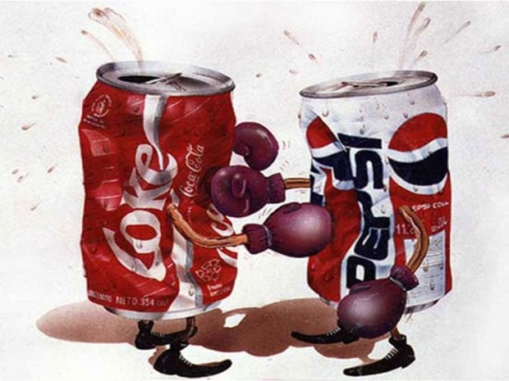
The Dynamics of Market
“ Use Value ”
Price Value
Place Value
Competition
Customer

Slide 15
Government Regulations
Businesses and other organizations in the India are regulated in many areas.
Laws determine
the payment of overtime wages,
the provisions that must be made for disabled persons,
limits on polluting the environment,
minimum safety standards for goods produced, the use of child labor, etc.
The proper role of supervisors and other managers is to know these regulations and seek ways of improving productivity without violating the law.

Slide 16
Economic Factor
Inflation
Economic

Slide 17
READING: Productivity Gains Curb Inflation
Wage increases can lead to inflationary pressure. They can cause the prices consumers pay for products and services to rise—unless, that is, they are offset by gains in productivity, which lead to an increase in profits. If that happens, a portion of the resulting profits can be used to cover the wage increases without having to raise prices. Some Burger Kings were able to increase the starting pay of new workers by $1 by achieving productivity gains. The restaurants restructured the menu, combining items into meal packages such as a burger, fries, and soft drink. This enabled the counter staff to enter orders with a single keystroke instead of multiple keystrokes on their point-of-sale machines, reducing the time needed to take an order. That, in turn, enabled them to take orders more quickly, increasing productivity and, consequently, reducing labor requirements, which produced higher profits.

Slide 18
Economic Factor
Inflation
GDP
Economic
GNP
Interest Rate
LPG
International Market

